Slide 1
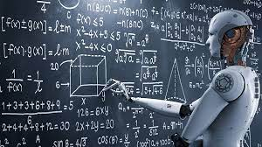
Machine Learning
...and carry the one...
Image Source

Slide 2
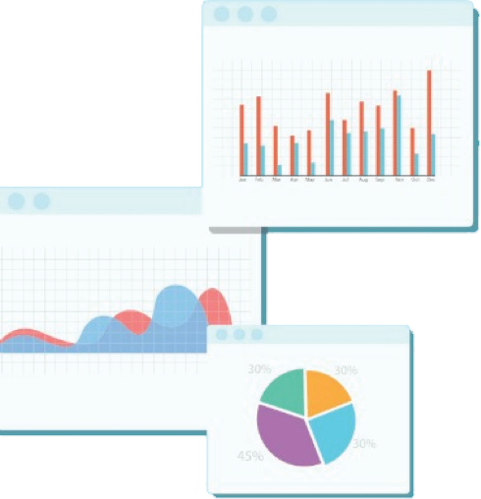

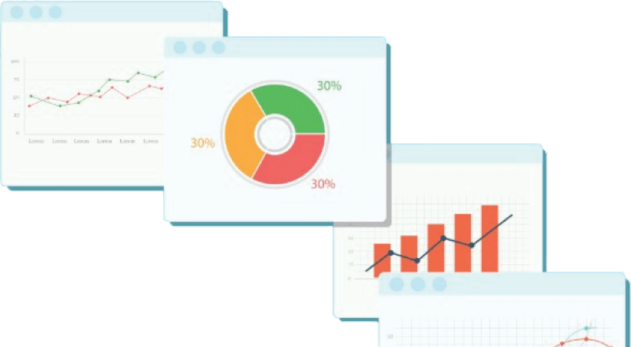
Welcome to Week 5
Lecture 1!
Data Science in Python &
Machine Learning

Slide 3
Announcements:
The new stack is open. Make sure to go to the Learn Platform and start working in the new stack.
The Machine Learning Calendar has been posted and is linked here.
Make sure to sign up for Group Code Reviews again if you would like to continue or start to have a group code review.
Check your feedback document on a regular basis.

Slide 4
Assignments Due This Week by
Sunday night
Abalone Preprocessing Exercise (Core)
Pipelines Activity (Core)
Project 1 - Part 5 (Core)

Slide 5
Warm up
What is Machine Learning?

Slide 6
Learning Goals
After this class you will be able to:
Explain what machine learning is and what it does
Describe the different major categories of machine learning
Define ‘model validation’ and explain how we know if a model is valid and will work in the real world
Explain data leakage and how to avoid it
Use Standard Scaler to scale numeric values using without leaking data.

Slide 7
Questions Machine Learning Answers:
Does the patient have cancer?

Slide 8
Questions Machine Learning Answers:
Does the patient have cancer?
How much will my house sell for?

Slide 9
Questions Machine Learning Answers:
Does the patient have cancer?
How much will my house sell for?
How old is this animal?

Slide 10
Questions Machine Learning Answers:
Does the patient have cancer?
How much will my house sell for?
How old is this animal?
Will the client repay this loan?

Slide 11
Questions Machine Learning Answers:
Does the patient have cancer?
How much will my house sell for?
How old is this animal?
Will the client repay this loan?
Which customers are similar?

Slide 12
Machine Learning
Machine learning is an application of artificial intelligence that provides systems the ability to automatically learn and improve from experience without being explicitly programmed.

Slide 13
Machine Learning
Supervised Learning
Unsupervised Learning

Slide 14
Machine Learning
Supervised Learning
Unsupervised Learning
Regression
Classification

Slide 15
Machine Learning
Supervised Learning
Unsupervised Learning
Regression
Classification
Clustering
Dimensionality Reduction

Slide 16
Machine Learning
You are starting here!
Supervised Learning
Unsupervised Learning
Regression
Classification
Clustering
Dimensionality Reduction

Slide 17
Machine Learning
Supervised Learning
Unsupervised Learning
Specifically here!
Regression
Classification
Clustering
Dimensionality Reduction

Slide 18
Machine Learning
Stack 3...
Supervised Learning
Unsupervised Learning
Regression
Classification
Clustering
Dimensionality Reduction

Slide 19
Supervised Learning

Slide 20
Supervised Learning
Under supervision! Has a target variable to learn patterns - fitting a “if this - then this” pattern.

Slide 21
Supervised Learning
Regression

Slide 22
Supervised Learning
Regression
When your goal is to predict a numeric variable.

Slide 23
Supervised Learning
Regression
When your goal is to predict a numeric variable.
ex. Predicting home prices, sales, etc.

Slide 24
Supervised Learning
Classification

Slide 25
Supervised Learning
Classification
When your goal is to predict a category or group.

Slide 26
Supervised Learning
Classification
When your goal is to predict a category.
ex. Predicting yes/no, low/medium/high, etc.

Slide 27
Unsupervised Learning

Slide 28
Unsupervised Learning
Without supervision! Has to learn patterns without a guide/target.

Slide 29
Supervised Learning has Features and a Target
Use this data to...
Predict this value or class
Column 0 | Column 1 | Column 2 | Column 3
Features Array (X)
Target Vector (y)

Slide 30
Model Validation
We trained our model by giving it data with the targets, but…
How do we know our model will be successful on new data with no targets?

Slide 31
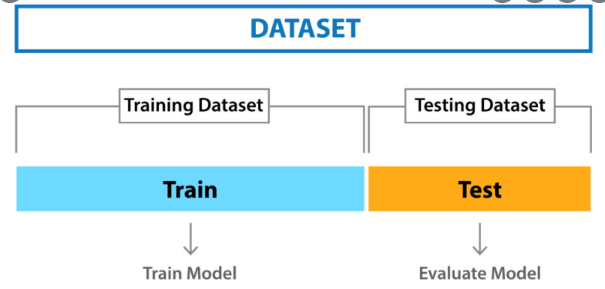
Split data into a training set and a testing set
Computer “sees” all the features AND the correct answers
It “learns” and develops the model
Computer only “sees” features (no answers)
It makes a prediction
We then compare prediction to our known “answer”
This simulates making predictions when the answer is truly not known yet

Slide 32
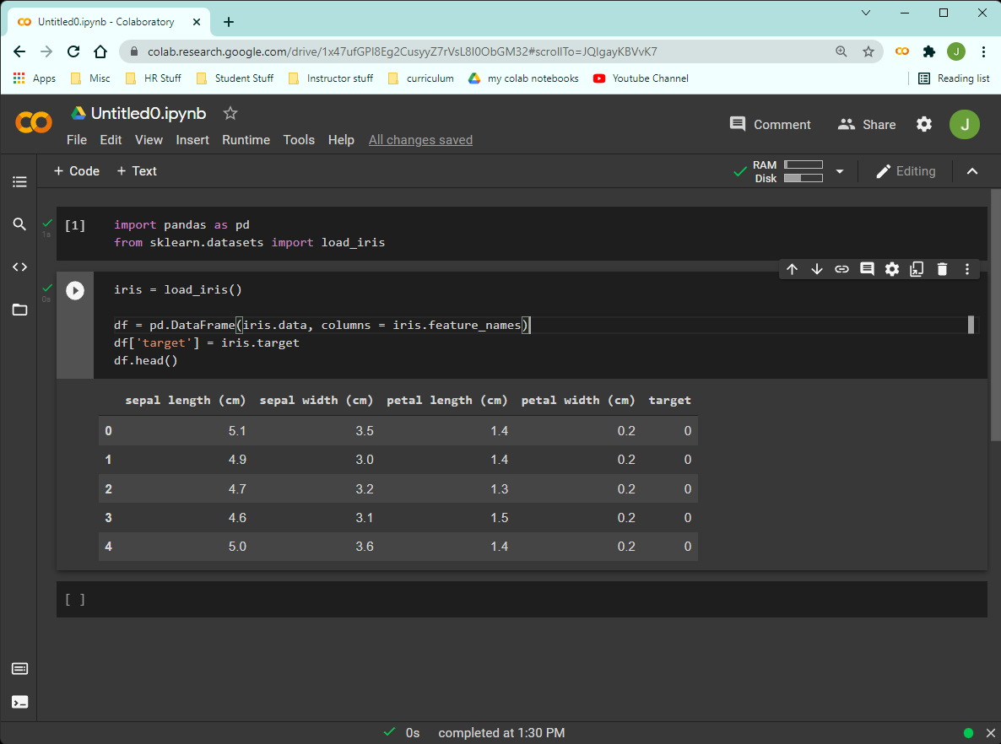
Machine Learning in Python: Scikit-Learn
AKA
sklearn
One stop shopping for machine learning tools
Works great with Pandas and Numpy!
LARGE library
Only import what we want.
from sklearn import <what you want>

Slide 33
Prepare the Data:
The Iris Dataset

Slide 34
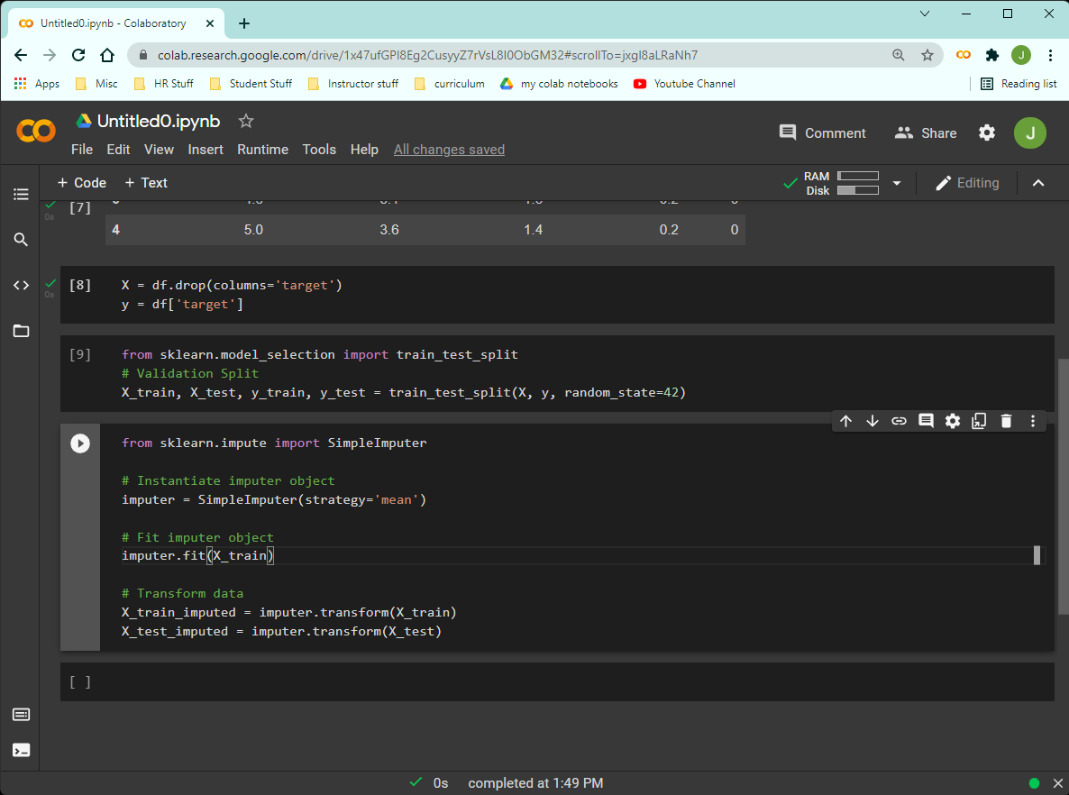
Prepare the Data:
X = features, y = target

Slide 35
Model Validation in Python:
In chat, answer: Why do we split the data into train and test sets?

Slide 36
Standard Scaler - Why We Scale
We scale for certain machine learning models.
To scale means to change the range of values but the distribution stays the same.
Standardize - to scale the values so that the distribution has a standard deviation of 1 with a mean of 0.
Scaled values lose their original units.
To avoid data leakage, the scaler should only be fit on the training set.

Slide 37
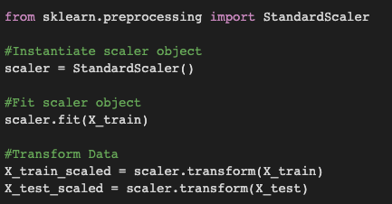
Transforming Data in Python:
Standard Scaler (scales data)
Fit on Train
Does NOT change in place.
Transform both Train and Test

Slide 38
Transforming Data in Python:
StandardScaler (scales data)
In sklearn:
.fit() learns from data (means, medians, standard deviations, etc.)
.transform() returns transformed data
Testing data simulates UNSEEN data
Nothing should ever learn from testing data
But it’s okay to transform testing data after learning from training data.

Slide 39
Transforming Data in Python:
Standard Scaler (scales data)
In chat, answer:
Why not just fit on all of X before splitting into X_train and X_test?

Slide 40
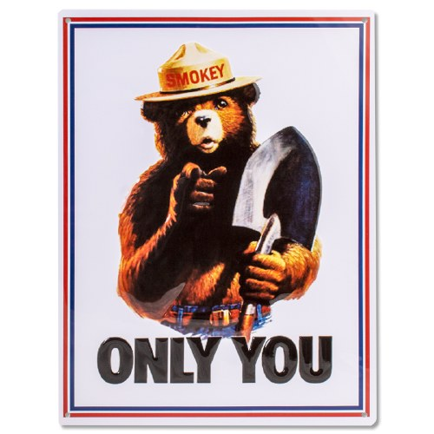
Model Validation in Python:
Can Prevent Data Leakage!

Slide 41
Thursday’s Topics
Data Preparation
One Hot Encoding
Simple Imputer
Pipelines
Pipelines and Column Transformers

Slide 42
CodeAlong Notebook

Slide 43
Challenge
Import the data
Split columns into X features and y target
Split rows into training and testing sets
Use Standard Scaler to scale the data WITHOUT leaking data.
Challenge Notebook

